Slide 1
www.MyValleyoftheMoon.org

Slide 2
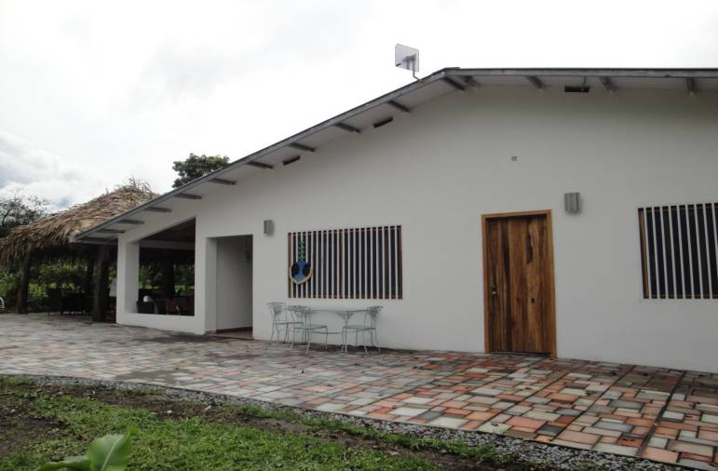
Valley Of the Moon restaurant
BeyondOrganic™ Teaching Kitchen, Restaurant & Internet Café

Slide 3
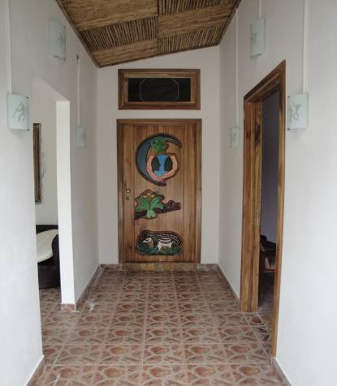
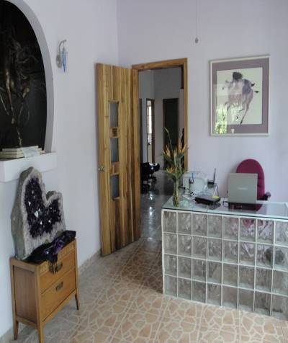
Entrada principal y recepción
Main Entrance
Reception Room

Slide 4
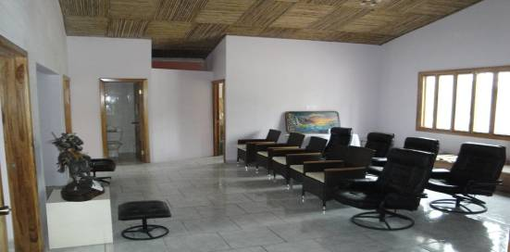
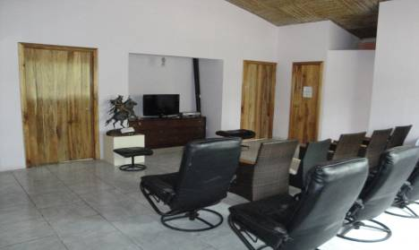
Sala de conferencias
Conference Room

Slide 5
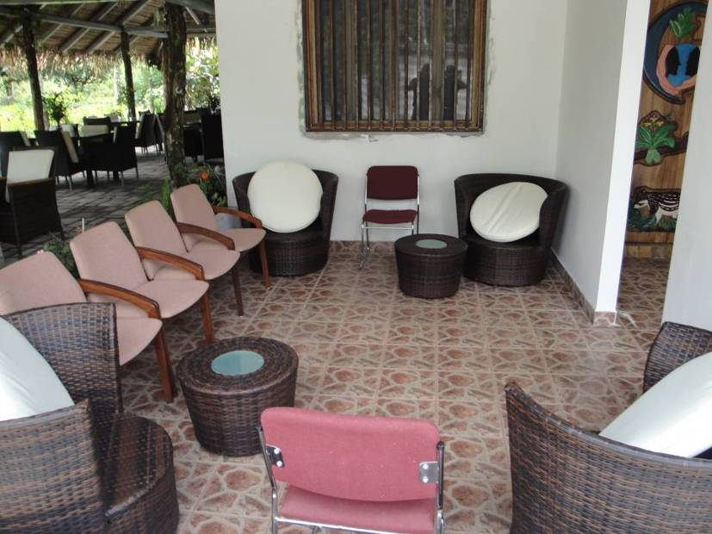
área de reposo

Slide 6
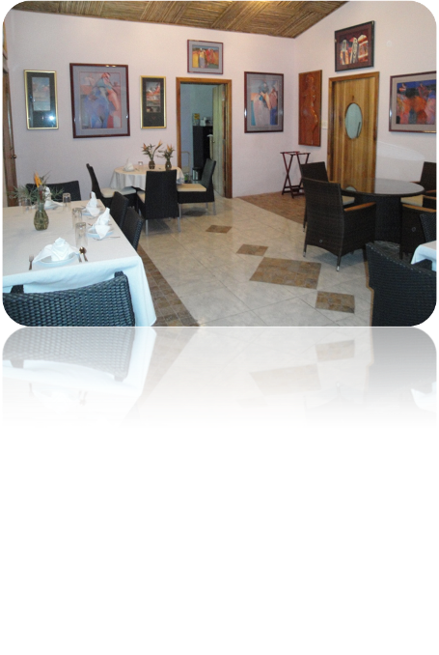
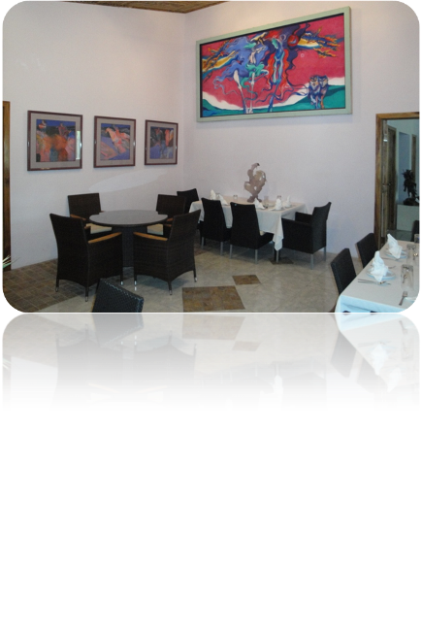
Comedor interior
All Artwork Displayed Courtesy of Dr. Laibow and Gen. Stubblebine

Slide 7
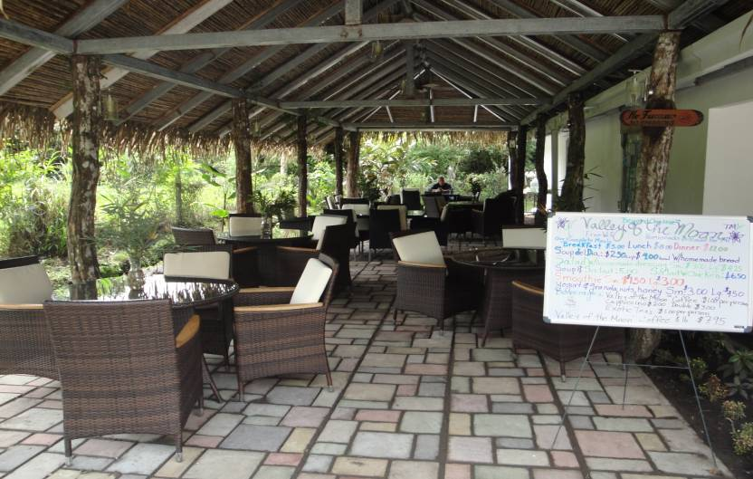
Comedor exterior
The Water Wall Dining Patio

Slide 8
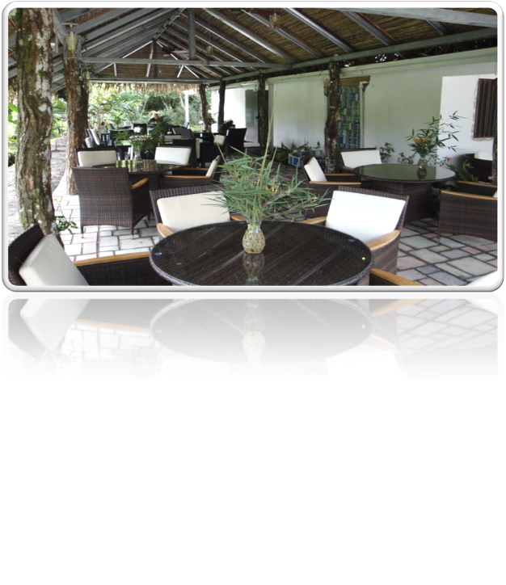
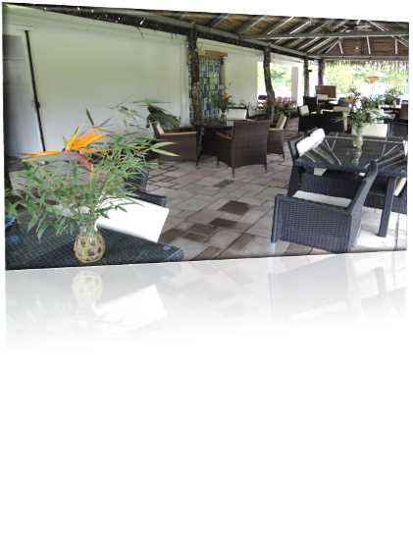
Comedor exterior

Slide 9
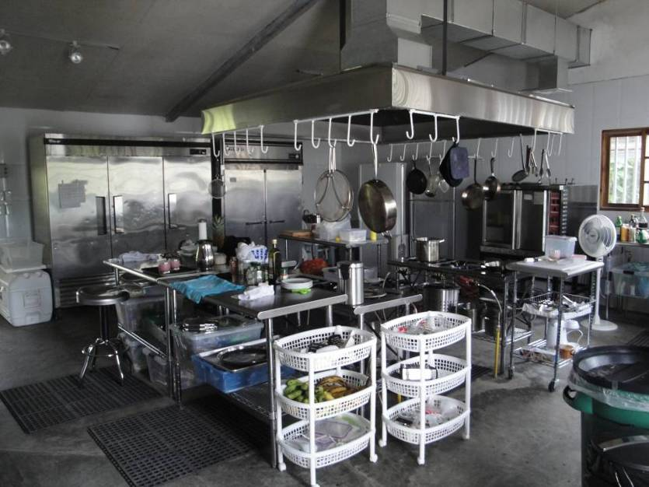
Cocina

Slide 10
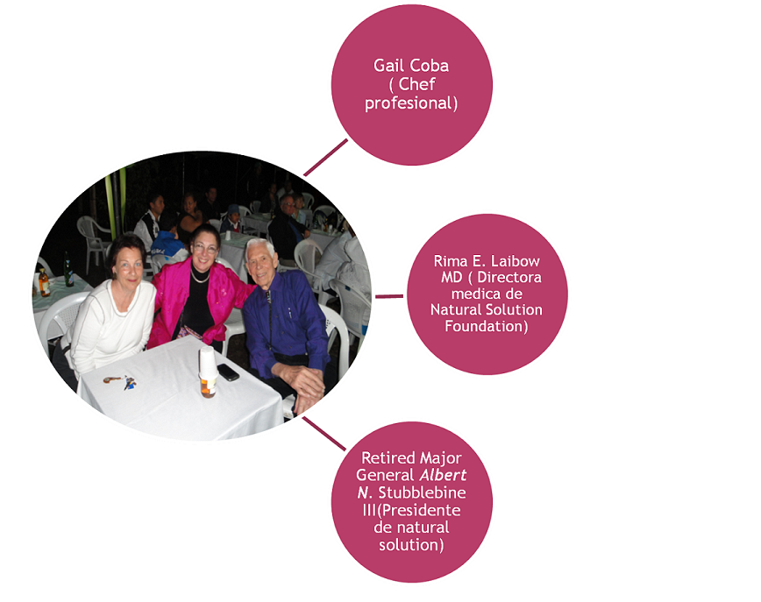

Slide 11
Available through: www.NaturalSolutionsMarketplace.org
© 2010

